Slide 1
Retrieving Data for Computation, Analysis, and Reference
Chapter 5
Notes:
Use the quote as a jumping off point for discussion, if desired.

Slide 2
Chapter Introduction
Reference and Lookup functions
Look up data based on its location in a table
Retrieve a corresponding value that matches specified criteria
Lookup table
A data list that categorizes values you want to retrieve
To go to Level 1, click here
To go to Level 2, click here
To go to Level 3, click here

Slide 3
Functions Covered in This Chapter
CHOOSE
HLOOKUP
IFERROR
INDEX
ISBLANK
LOOKUP
MATCH
VLOOKUP

Slide 4
Level 1 Objectives: Performing Basic Lookups to Calculate and Evaluate Data
Organize and evaluate data in vertical and horizontal lookup tables
Understand the VLOOKUP and HLOOKUP function rules
Retrieve data from a vertical lookup table
Retrieve data from a horizontal lookup table

Slide 5
Working with Lookup Tables
Lookup tables
Contain data that can be used to create worksheets that list items, and then perform calculations
Automate the process of looking up data to use in calculating unit and total prices
Level 1 home

Slide 6
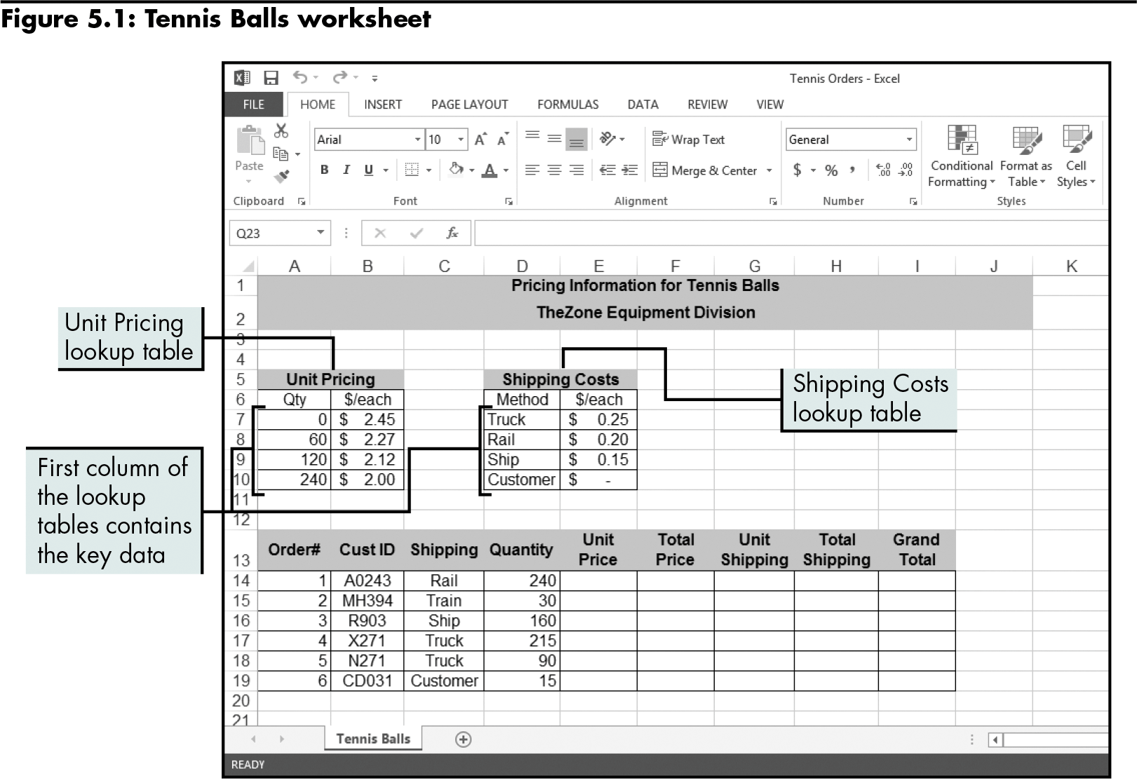
Working with Lookup Tables (continued)
Level 1 home

Slide 7
Retrieving Data from a Vertical Lookup Table
VLOOKUP function
The most effective and flexible way to retrieve data organized in columns
Searches a specified part of a worksheet for data, starting with the first column
=VLOOKUP(lookup_value,table_array, col_index_num,range_lookup)
Must specify col_index_num
Level 1 home

Slide 8
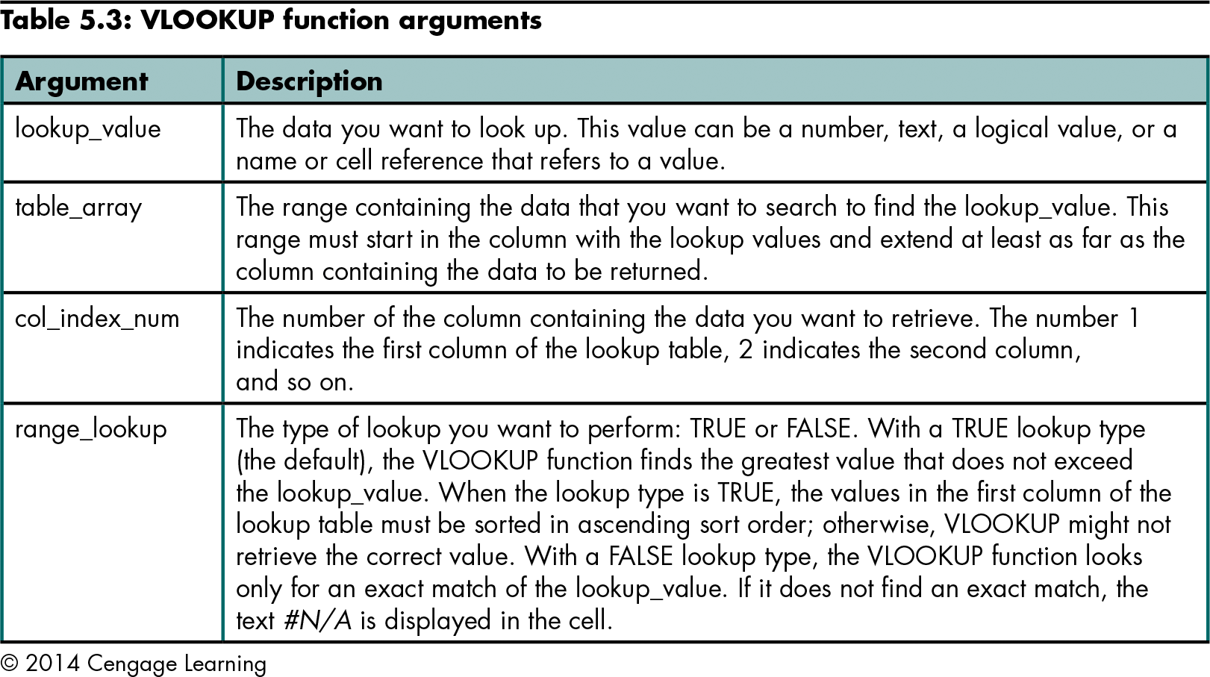
Retrieving Data from a Vertical Lookup Table (continued)
Level 1 home

Slide 9
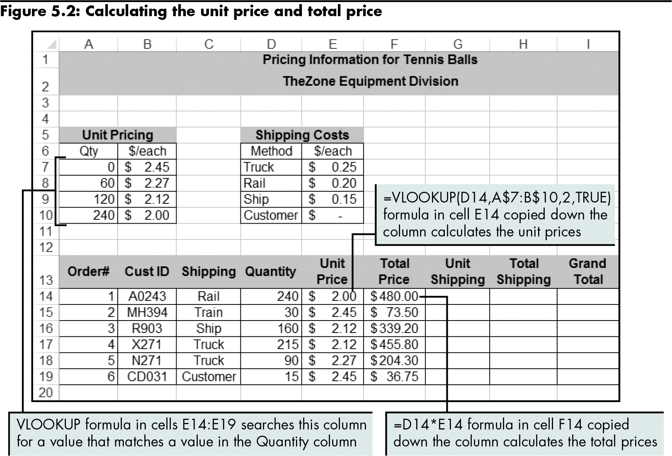
Retrieving Data from a Vertical Lookup Table (continued)
Results of using the VLOOKUP function
Level 1 home

Slide 10
Retrieving Data from a Vertical Lookup Table (continued)
Steps that Excel performs when the VLOOKUP type is TRUE and key data is sorted in ascending order:
Look for an exact match
Check the first value in the lookup table
Check the next value in the lookup table
Check the last value in the lookup table
Level 1 home

Slide 11
Retrieving Data from a Vertical Lookup Table (continued)
If using a type FALSE, the VLOOKUP function looks only for an exact match of the lookup value
Values in a lookup table need not be sorted in ascending order
The VLOOKUP function displays #N/A in a cell if an exact match is not found
Level 1 home

Slide 12
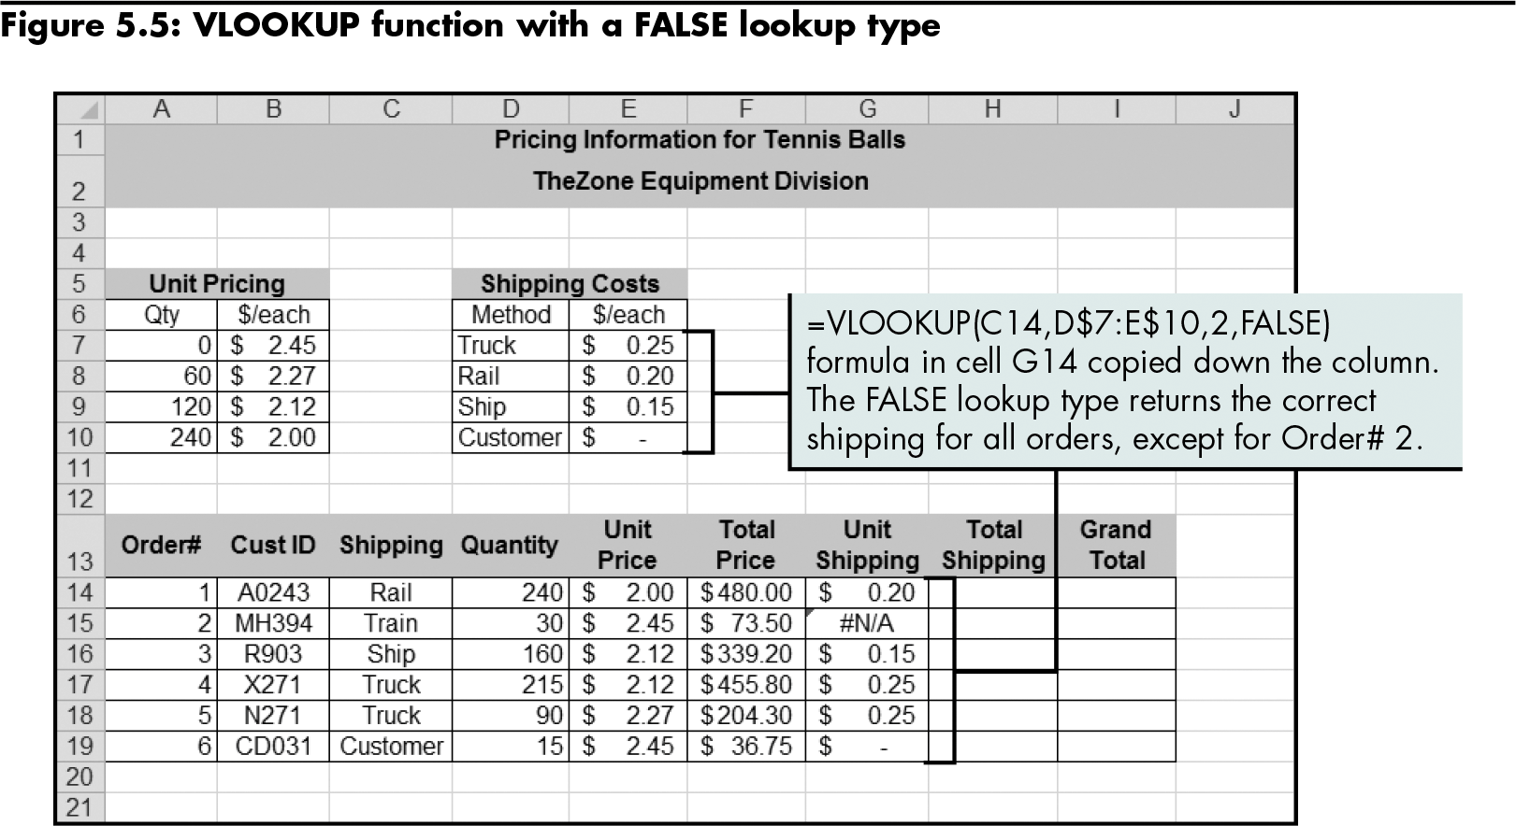
Retrieving Data from a Vertical Lookup Table (continued)
Level 1 home

Slide 13
Retrieving Data from a Horizontal Lookup Table
HLOOKUP function
Looks up a value by testing for a criterion across a row
=HLOOKUP(lookup_value,table_array, row_index_num,range_lookup)
Must specify row_index_num
Level 1 home

Slide 14
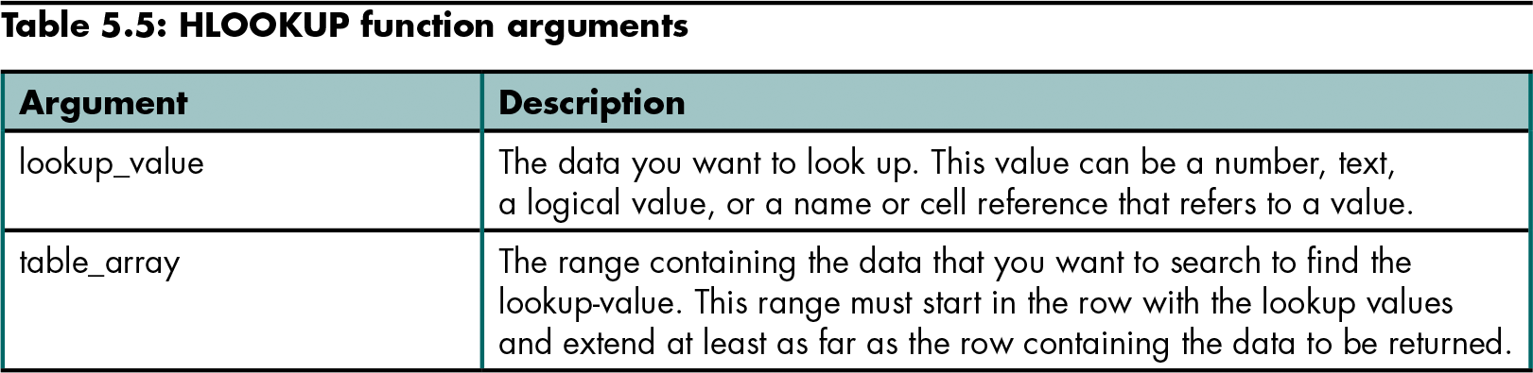
Retrieving Data from a Horizontal Lookup Table (continued)
Level 1 home

Slide 15
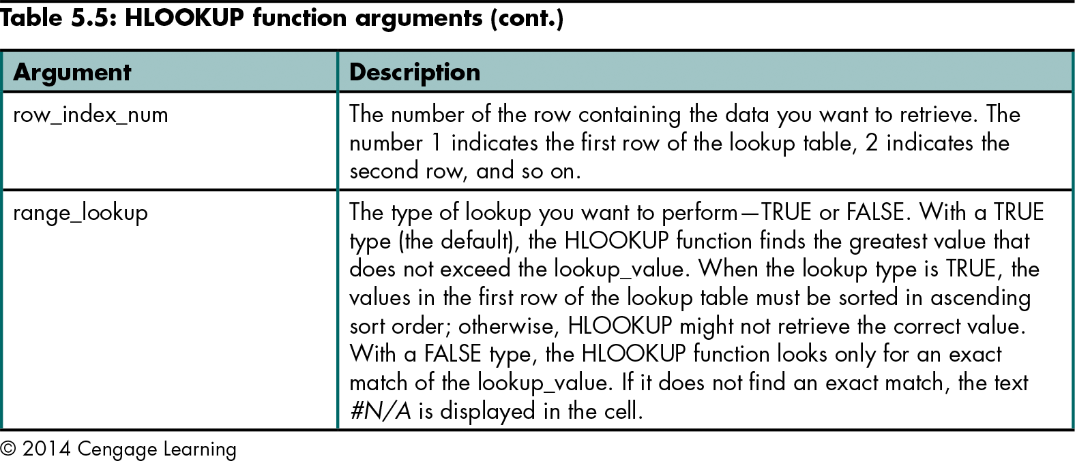
Retrieving Data from a Horizontal Lookup Table (continued)
Level 1 home

Slide 16
Retrieving Data from a Horizontal Lookup Table (continued)
HLOOKUP type TRUE algorithm
Works in the same way as for the VLOOKUP function, except that values are tested across the row (instead of down the first column)
The first row of the lookup table must be sorted in ascending order
Level 1 home

Slide 17
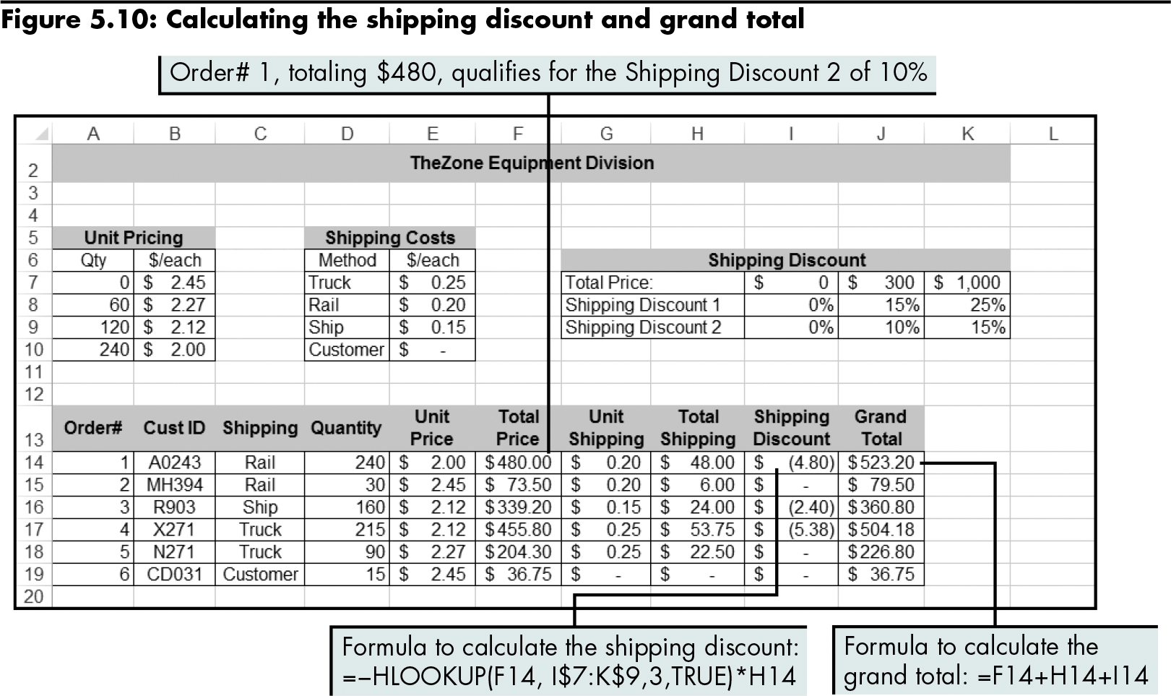
Retrieving Data from a Horizontal Lookup Table (continued)
Using the HLOOKUP function
Level 1 home

Slide 18
Level 1 Summary
VLOOKUP function
Use when the first column of the lookup table contains the key data, and information you want to retrieve is in a column to the right of the key data column
HLOOKUP function
Similar to VLOOKUP, except that it retrieves data stored in horizontal lookup tables
Use when the first row of the lookup table contains the key data, and the information you want to retrieve is in a row before the key data row

Slide 19
Level 2 Objectives: Performing More Complex Lookups Involving Multiple Worksheets and Multidimensional Tables
Analyze and retrieve data from multiple worksheets
Look up data in a one-row or one-column range
Use named range references in formulas
Retrieve data from multidimensional tables

Slide 20
Retrieving Data from Multiple Worksheets
Use VLOOKUP and HLOOKUP formulas
This is especially useful when lookup tables are long
Level 2 home

Slide 21
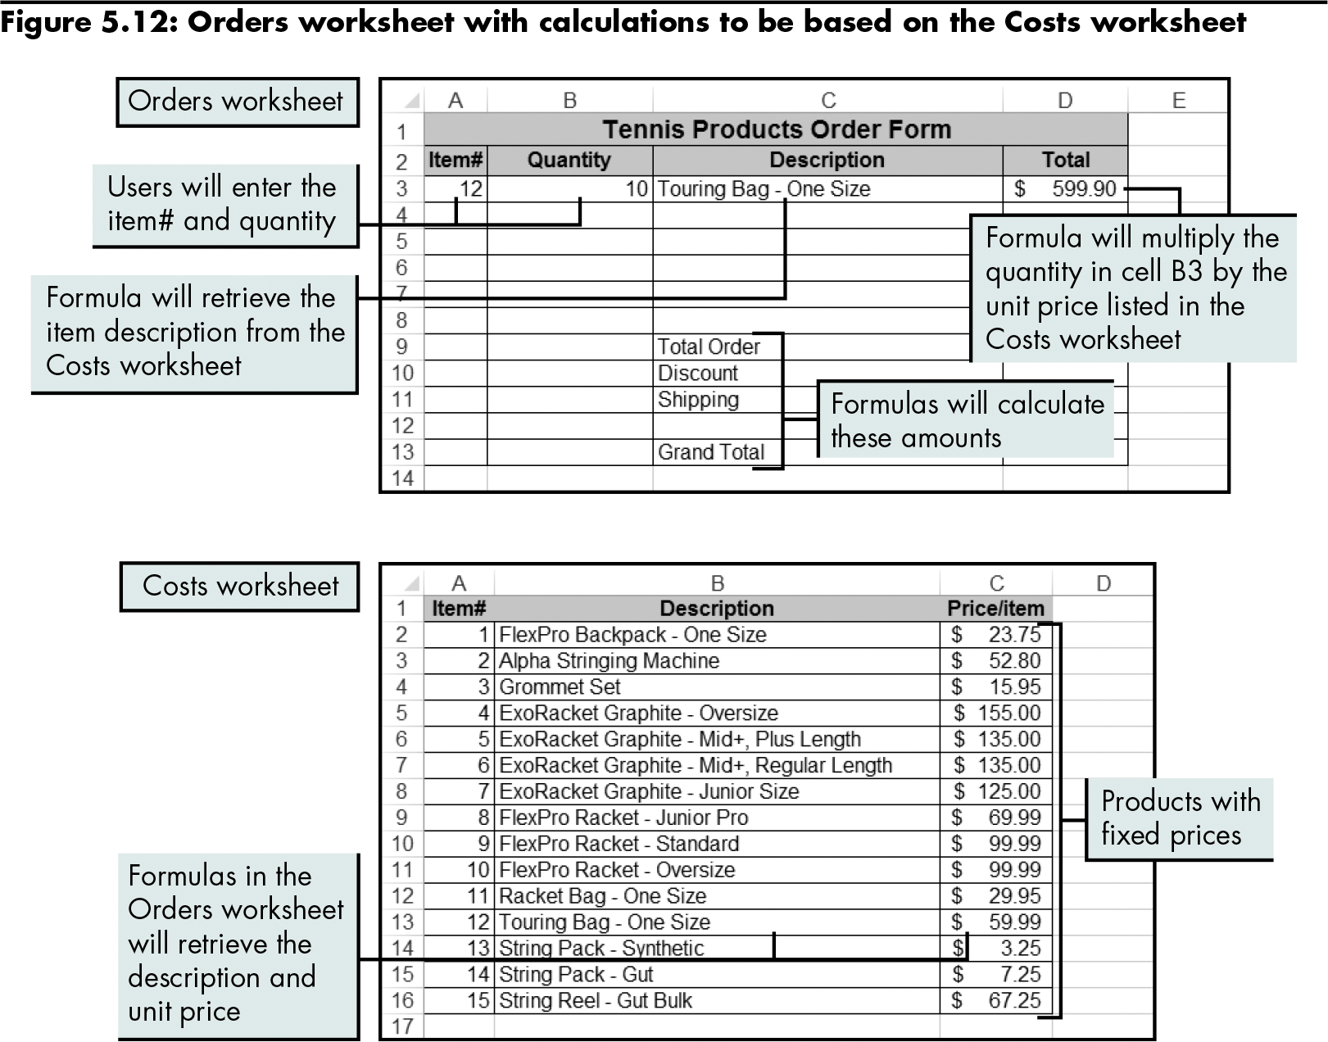
Retrieving Data from Multiple Worksheets (continued)
Level 2 home

Slide 22
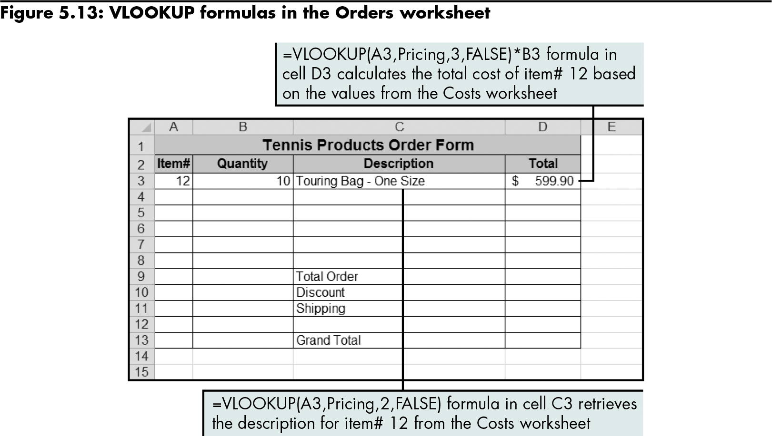
Retrieving Data from Multiple Worksheets (continued)
Using VLOOKUP with multiple worksheets
Level 2 home

Slide 23
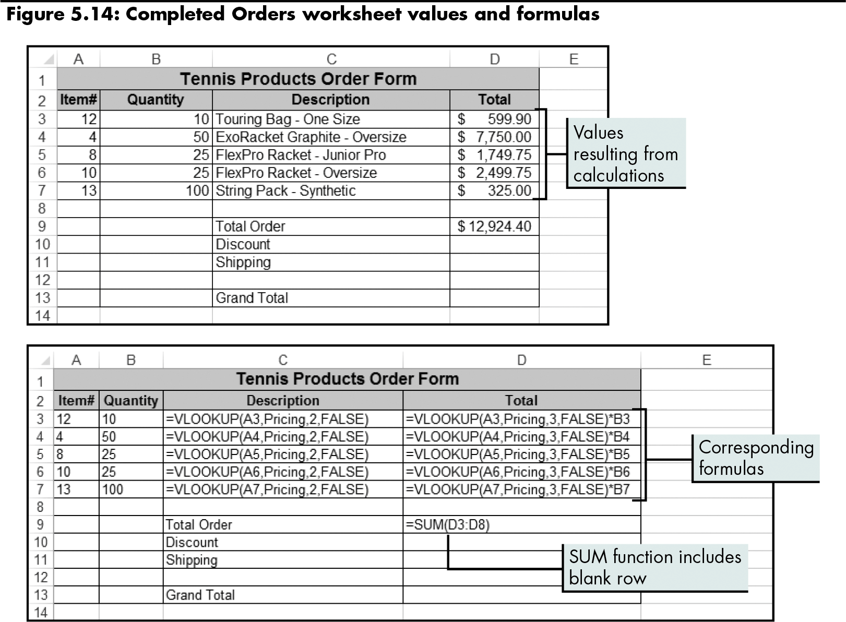
Retrieving Data from Multiple Worksheets (continued)
Level 2 home

Slide 24
Looking Up Data in a One-Row or One-Column Range
Use the LOOKUP function
Looks up the greatest value that does not exceed a specified value anywhere in a table or range
Can retrieve data from a lookup table with a vertical or horizontal orientation
Uses only a TRUE lookup type; the column or row containing lookup values must be in ascending order
=LOOKUP(lookup_value,lookup_vector, result_vector)
Level 2 home

Slide 25
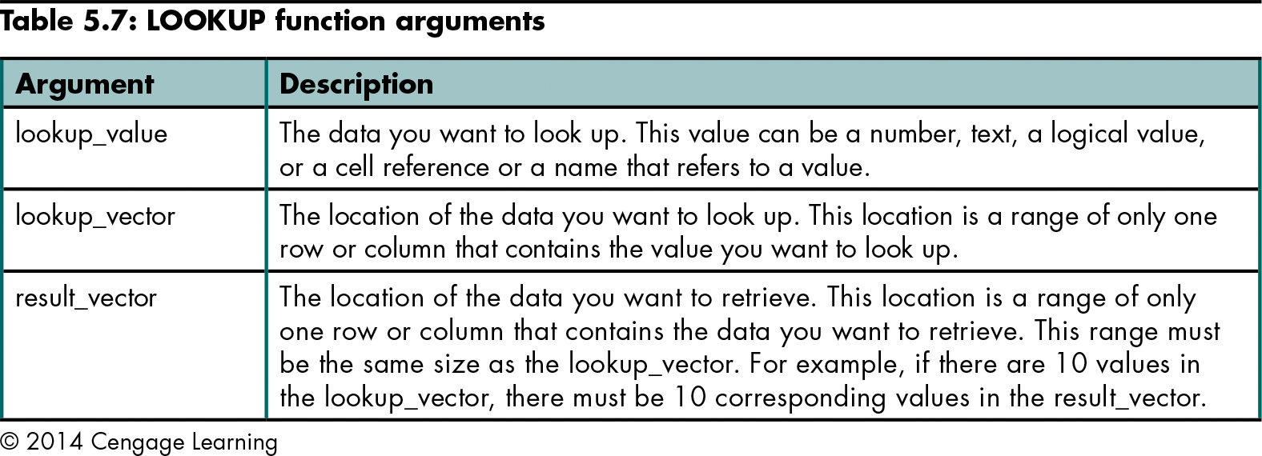
Looking Up Data in a One-Row or One-Column Range (continued)
Level 2 home

Slide 26
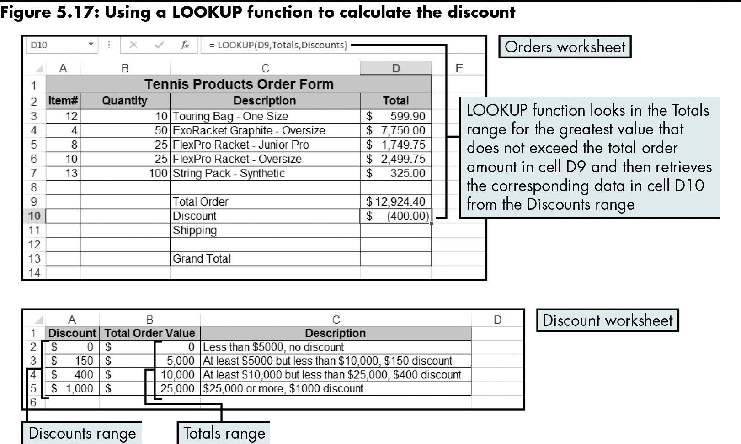
Looking Up Data in a One-Row or One-Column Range (continued)
Level 2 home

Slide 27
Retrieving Data from Multidimensional Tables
Use the INDEX function with two- or three-dimensional tables
Returns the value in a table based on the row and column numbers that you specify
=INDEX(reference,row_num,column_num, area_num)
Has several guidelines
Level 2 home

Slide 28
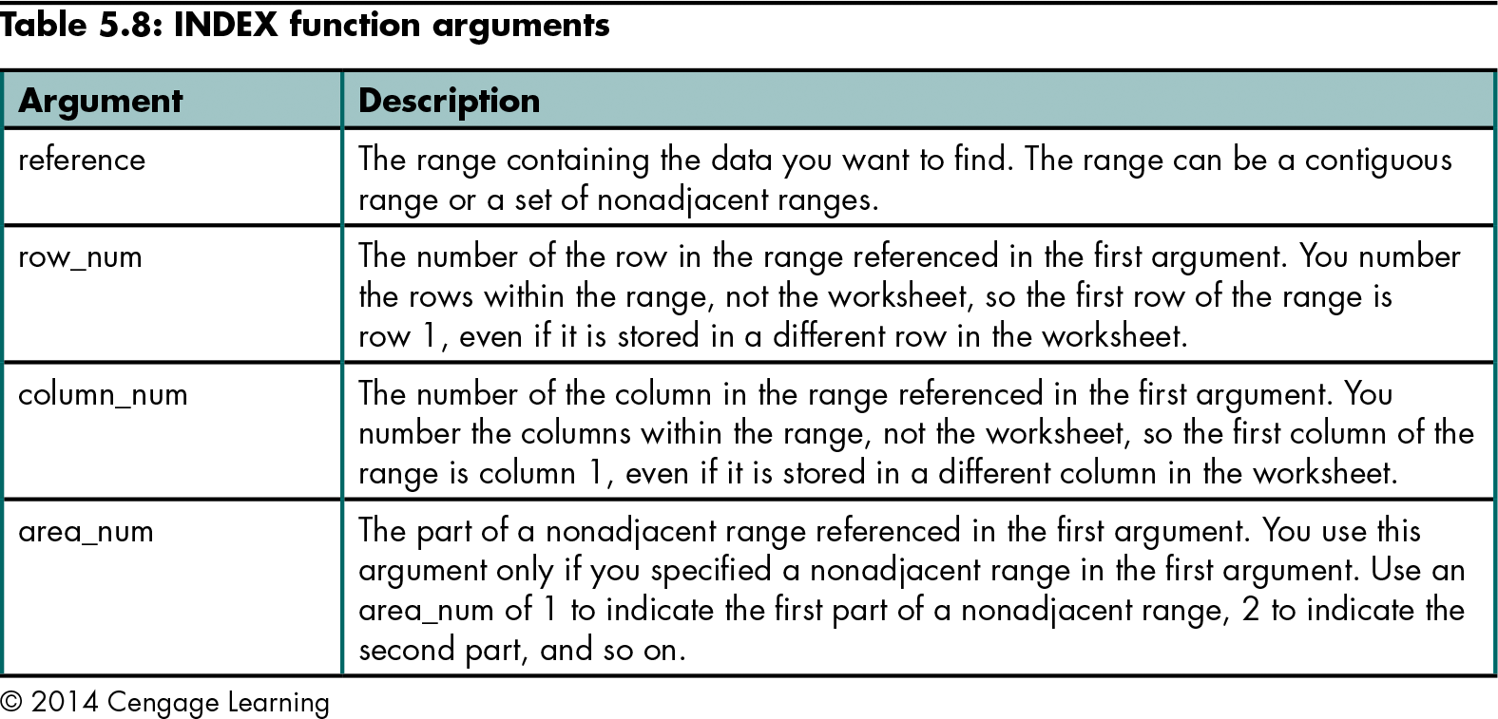
Retrieving Data from Multidimensional Tables (continued)
Level 2 home

Slide 29
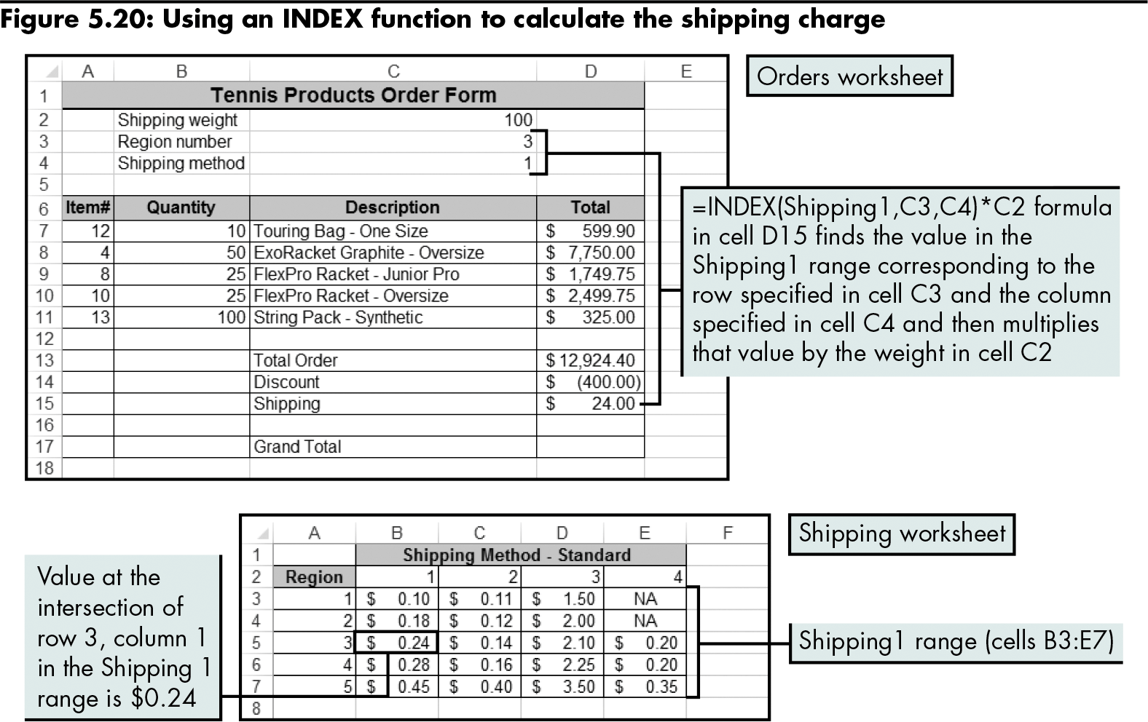
Retrieving Data from Multidimensional Tables (continued)
Using an INDEX function with a two-dimensional table
Level 2 home

Slide 30
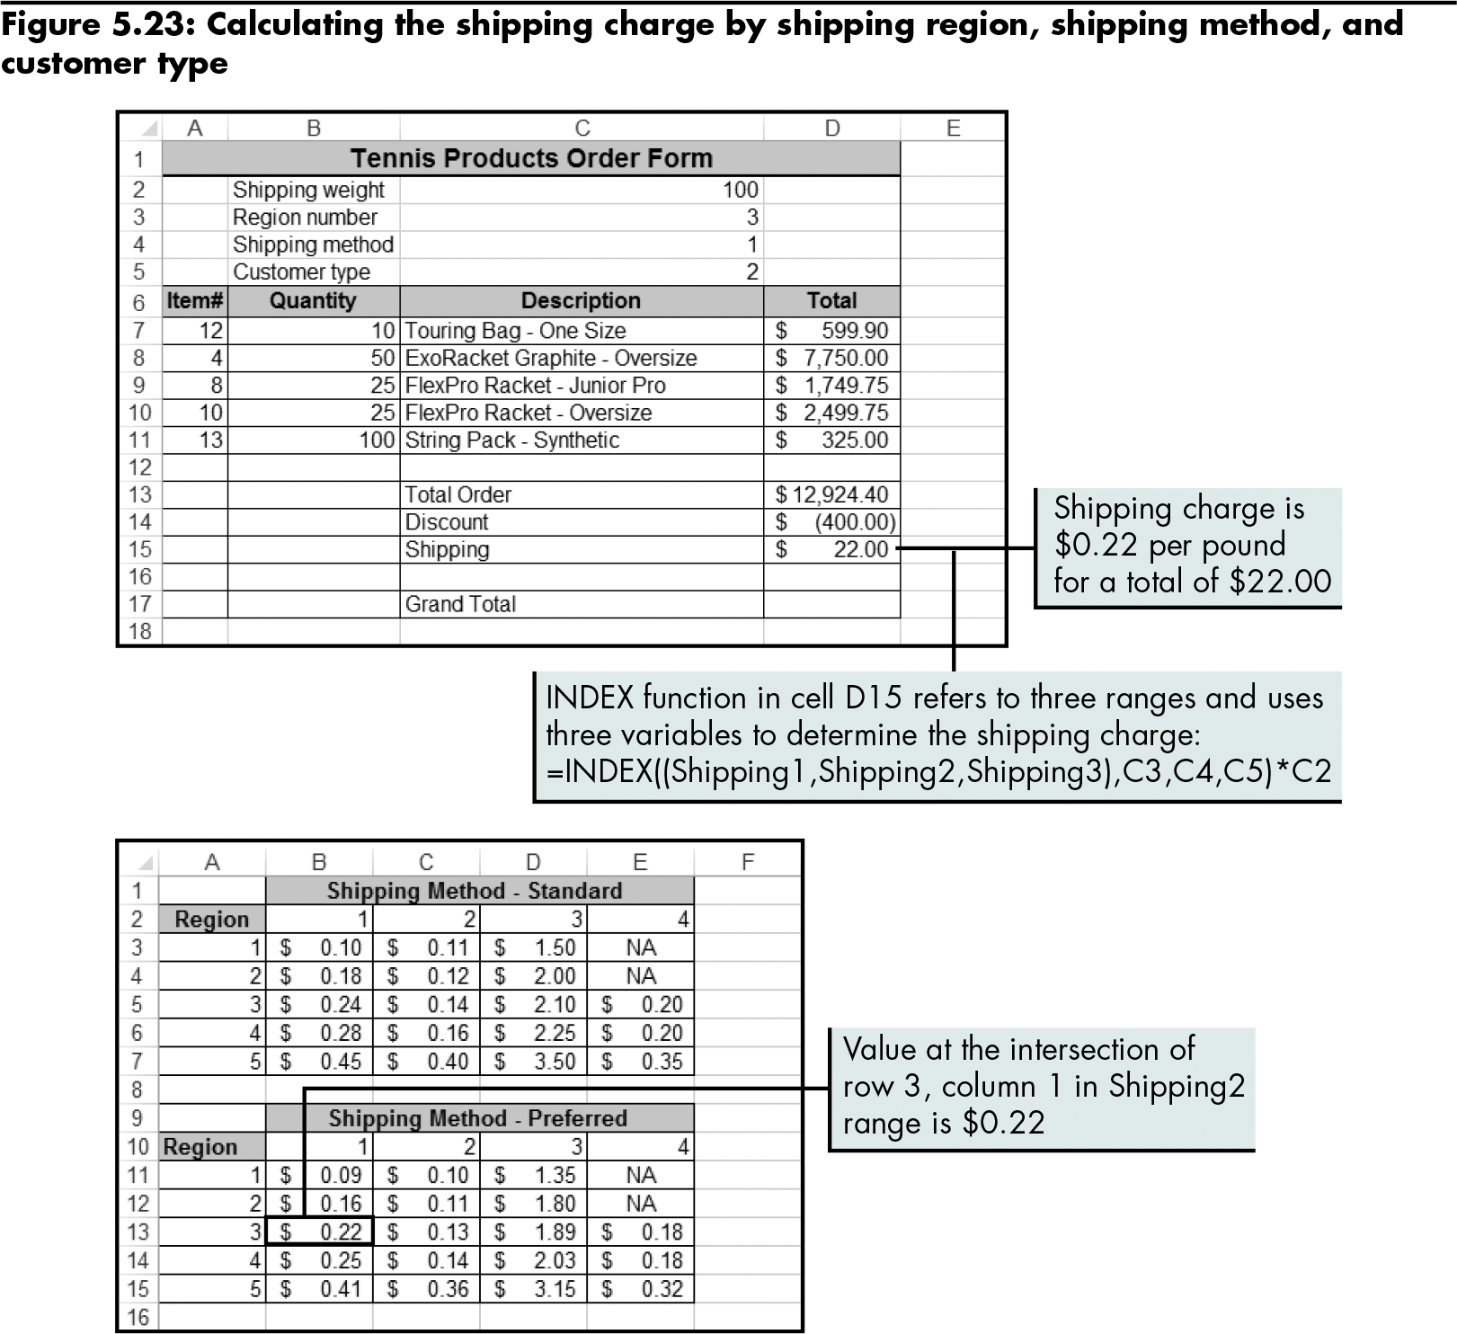
Retrieving Data from Multidimensional Tables (continued)
Using an INDEX function with a three-dimensional table
Level 2 home

Slide 31
Level 2 Summary
LOOKUP function
Looks up the greatest value that does not exceed a specified value anywhere in the table or range
Can retrieve data from a lookup table with a vertical or horizontal orientation
INDEX function
Allows retrieval of data from multidimensional tables

Slide 32
Level 3 Objectives: Nesting Lookup and Reference Functions to Retrieve and Calculate Data
Prevent errors in data retrieval
Nest lookup and reference functions to perform more complex calculations
Choose a value or a range of values for analysis
Retrieve data by matching the relative position of an item in a list

Slide 33
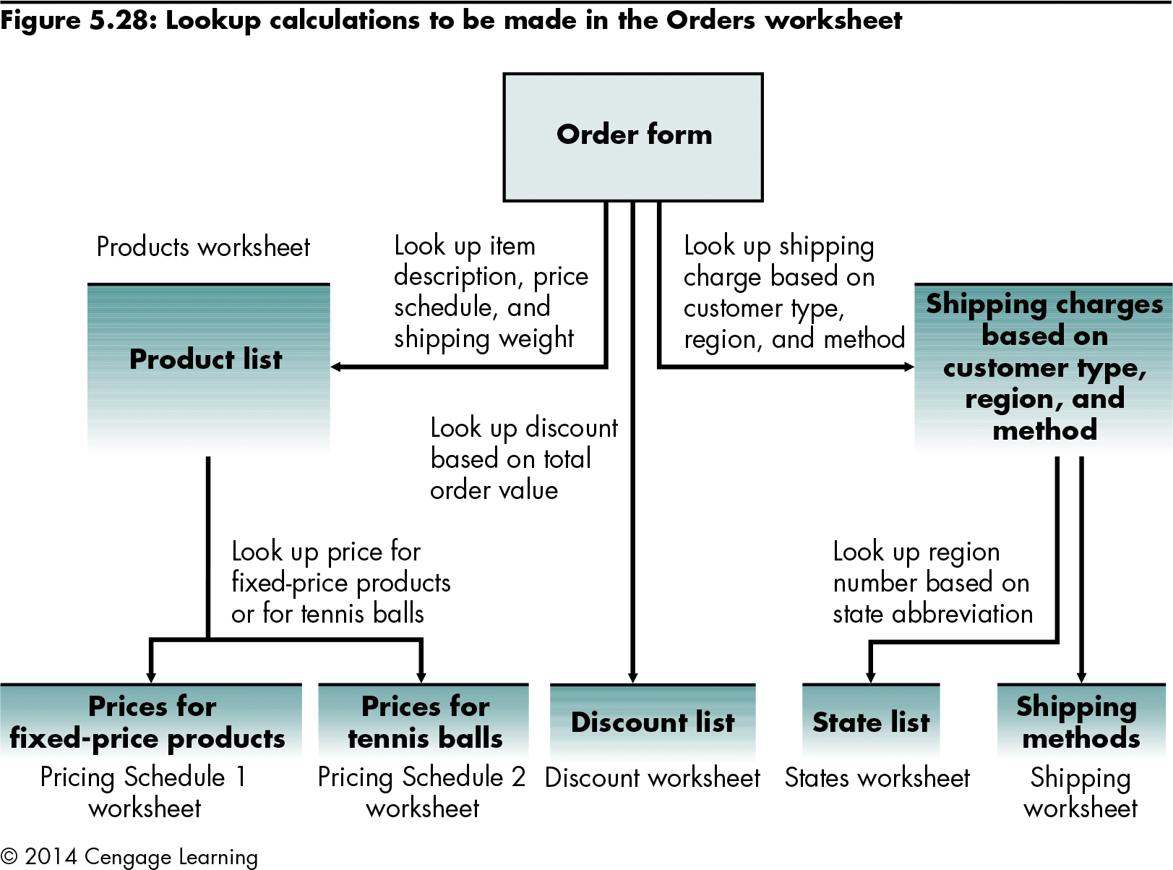
Refining the Order Form
Level 3 home

Slide 34
Preventing Errors in Data Retrieval
IS functions
Nine functions that test a value or cell reference, and then return a TRUE or FALSE value depending on the results
Often used in formulas to test the outcome of a calculation
When combined with the IF function, they help locate data-entry errors
=ISBLANK(value)
Level 3 home

Slide 35
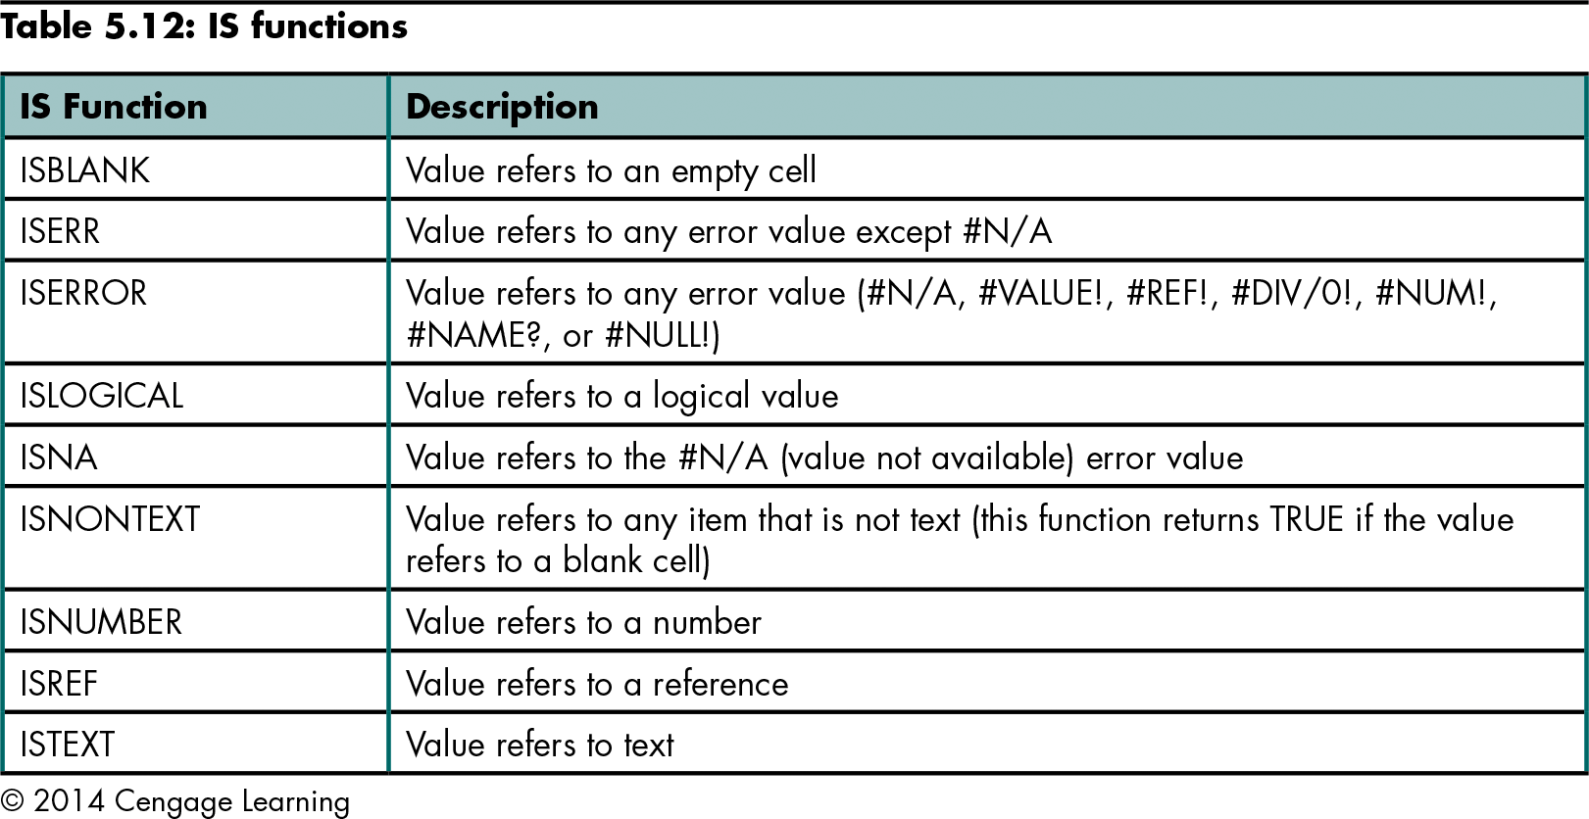
Preventing Errors in Data Retrieval (continued)
Level 3 home

Slide 36
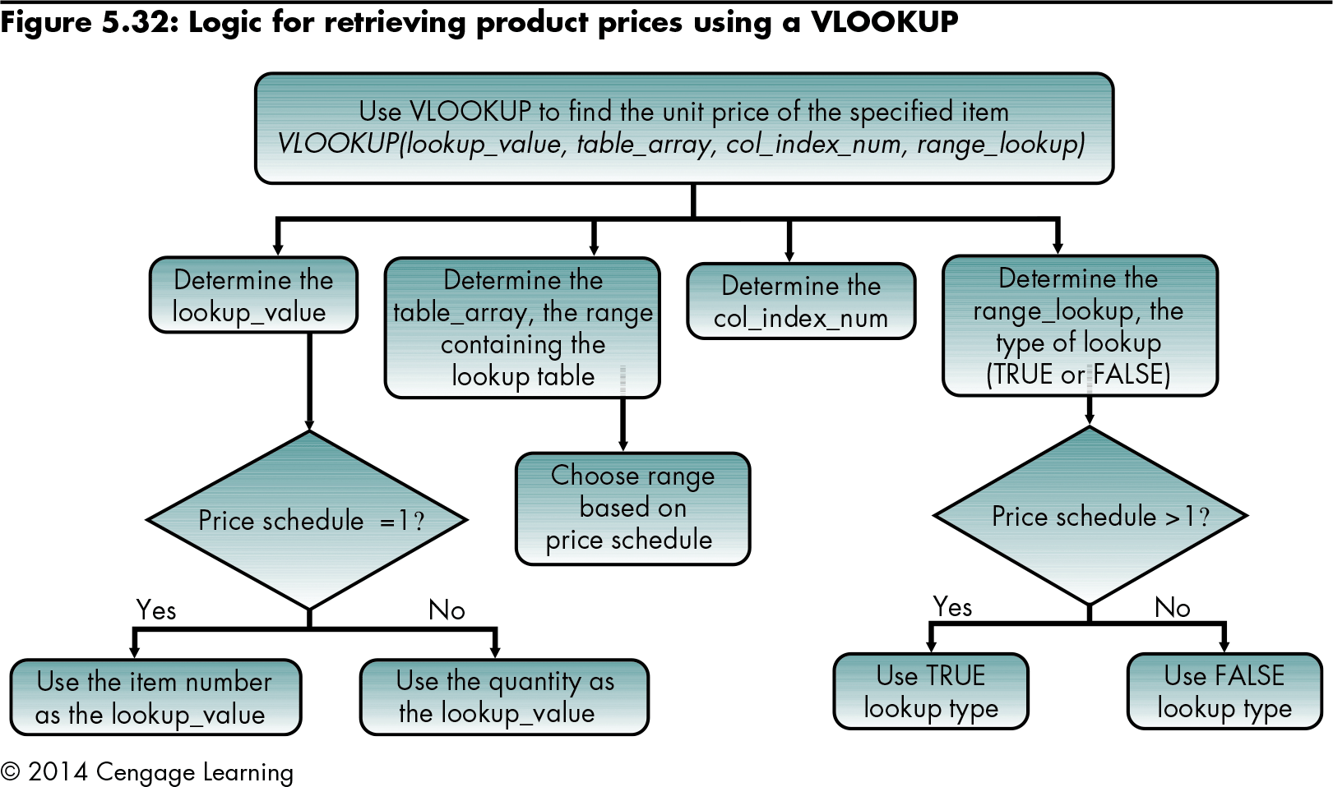
Nesting LOOKUP and IF Functions to Calculate the Price per Unit
Level 3 home

Slide 37
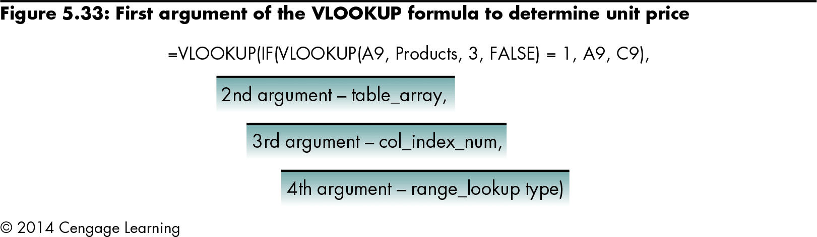
Nesting LOOKUP and IF Functions to Calculate the Price per Unit (continued)
Level 3 home

Slide 38
Nesting LOOKUP and IF Functions to Calculate the Price per Unit (continued)
CHOOSE function
A Reference and Lookup function that can return a value or a range for up to 254 different values
=CHOOSE(index_num,value1,value2,…)
Level 3 home

Slide 39
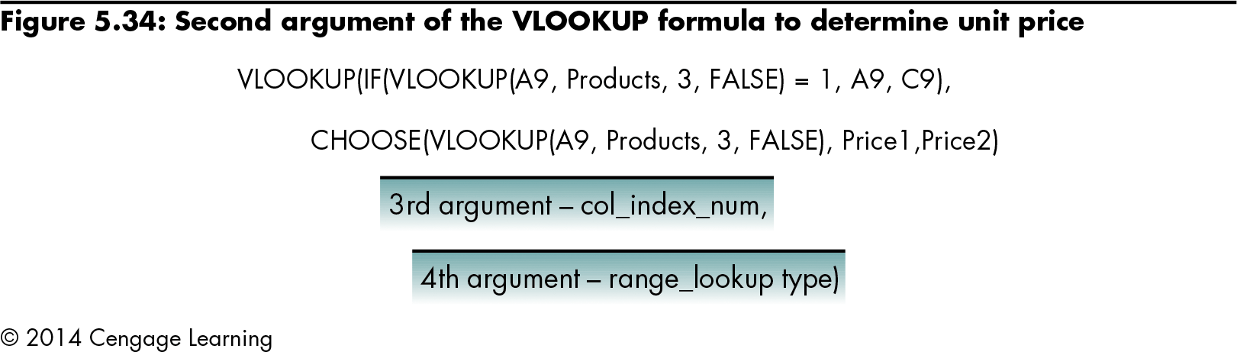
Nesting LOOKUP and IF Functions to Calculate the Price per Unit (continued)
Using the CHOOSE function to determine the table_array
Level 3 home

Slide 40
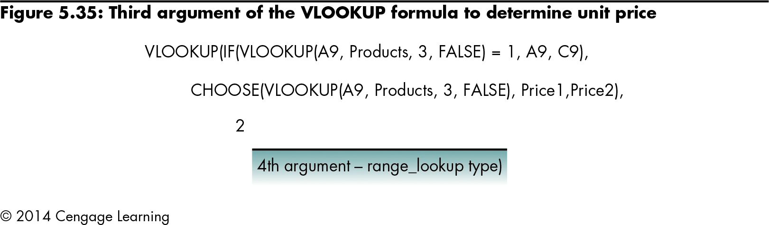
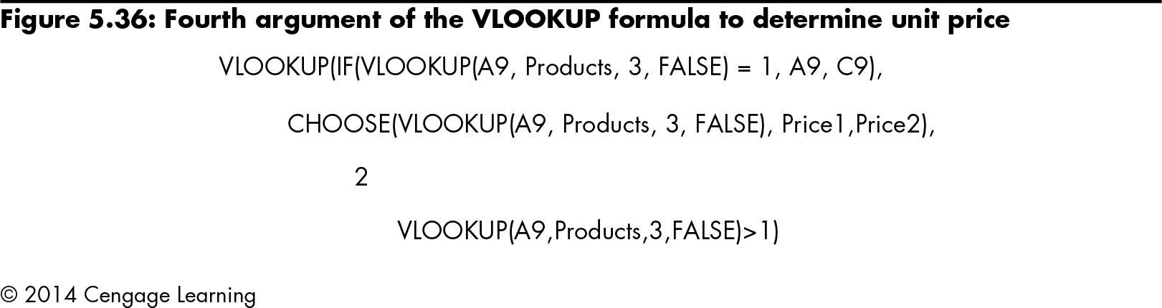
Nesting LOOKUP and IF Functions to Calculate the Price per Unit (continued)
Determining the col_index_num
Level 3 home

Slide 41
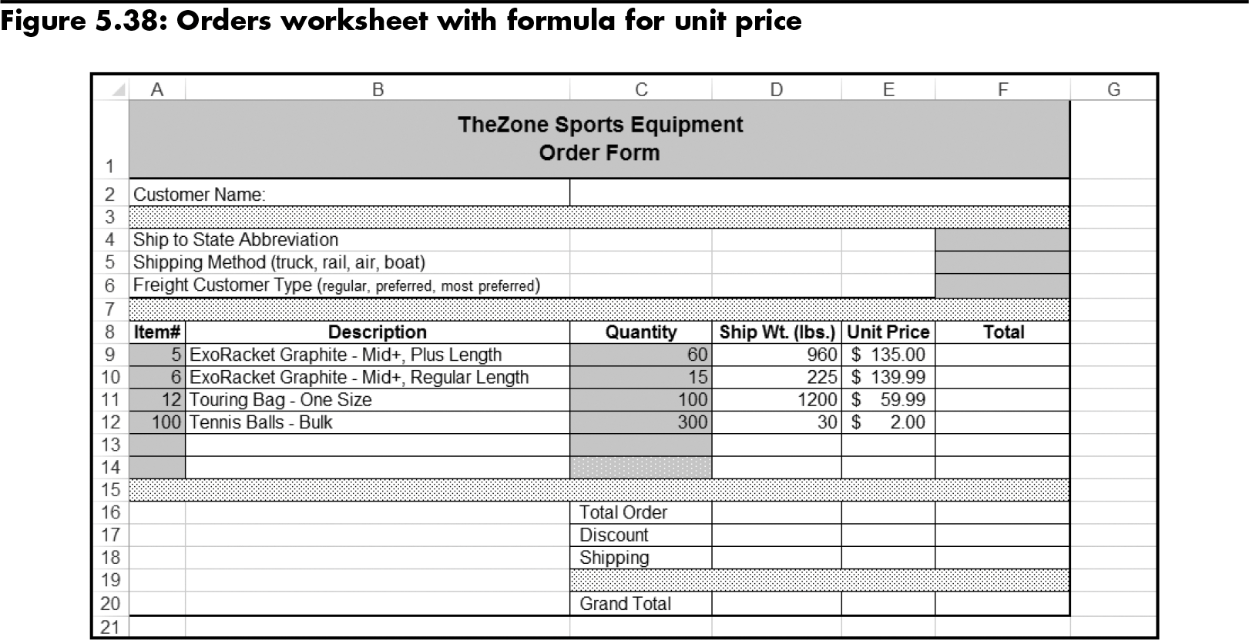
Nesting LOOKUP and IF Functions to Calculate the Price per Unit (continued)
Creating the nested VLOOKUP formula
Level 3 home

Slide 42
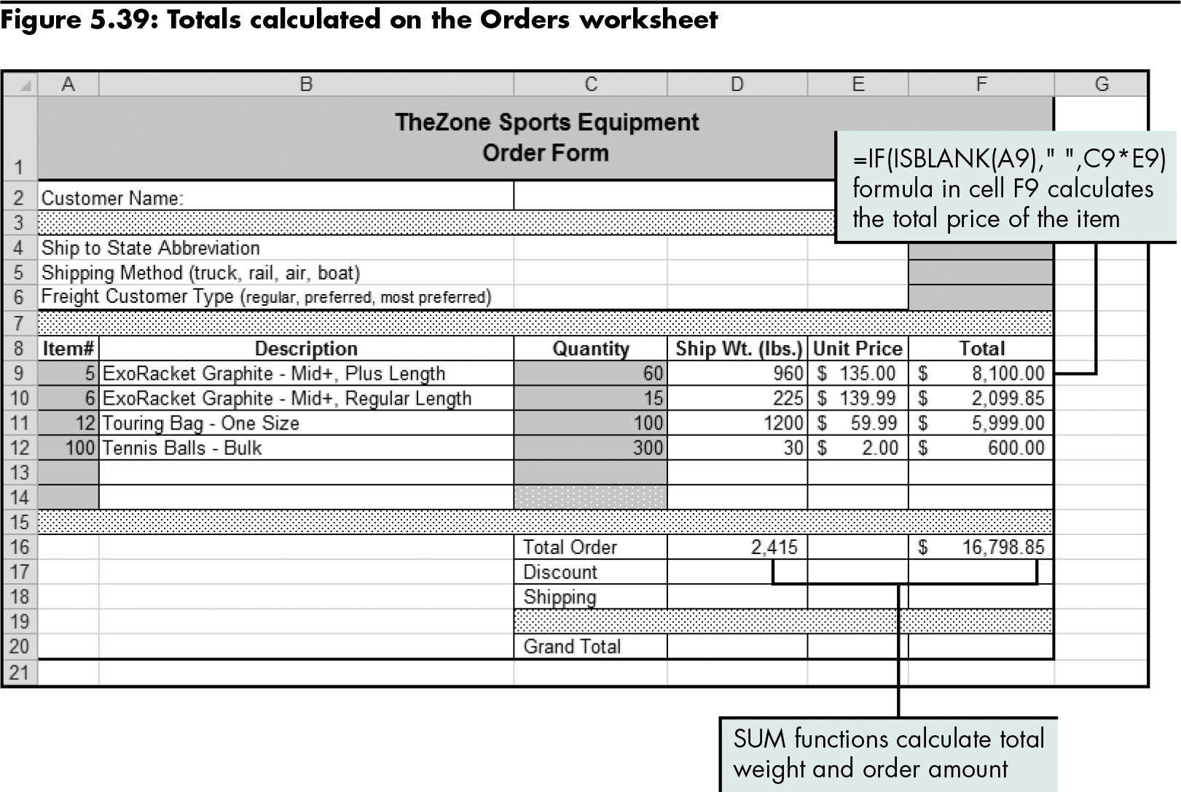
Calculating Totals
Level 3 home

Slide 43
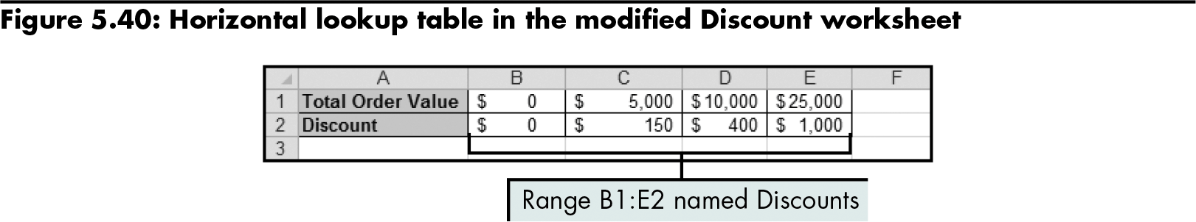
Calculating the Discount Amount
Level 3 home

Slide 44
Calculating the Shipping Costs Using MATCH and INDEX Functions
INDEX function
=INDEX(reference,row_num,column_num, area_num)
MATCH function
Designed to return the relative position of an item in a list
=MATCH(lookup_value,lookup_array, match_type)
Has several guidelines
Level 3 home

Slide 45
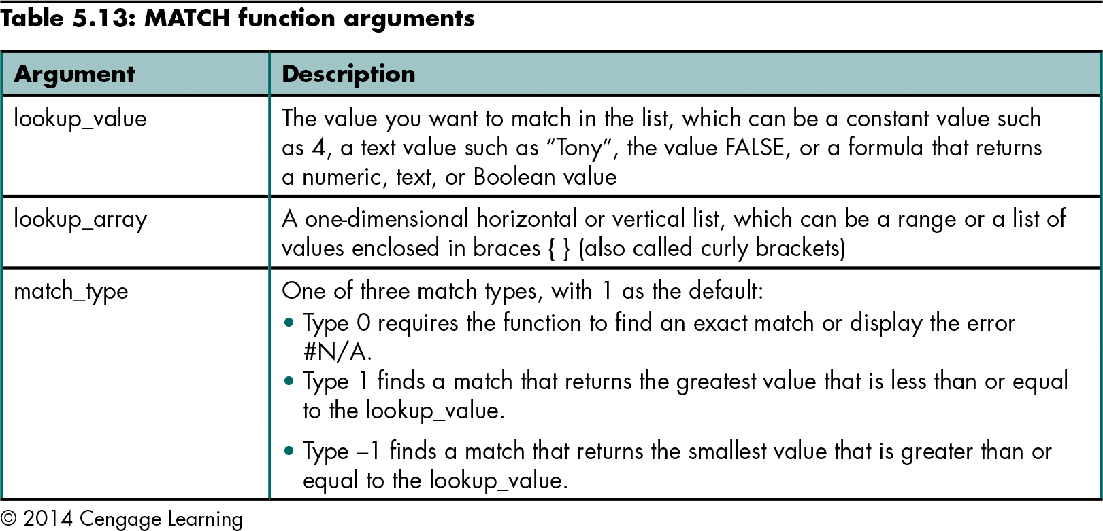
Calculating the Shipping Costs Using MATCH and INDEX Functions (continued)
Level 3 home

Slide 46
Calculating the Shipping Costs Using MATCH and INDEX Functions (continued)
Using the INDEX function:
Determine the reference argument of the INDEX function
Determine the row_num of the INDEX function
Determine the column_num of the INDEX function by using the MATCH function
Determine the area_num of the INDEX function
Level 3 home

Slide 47
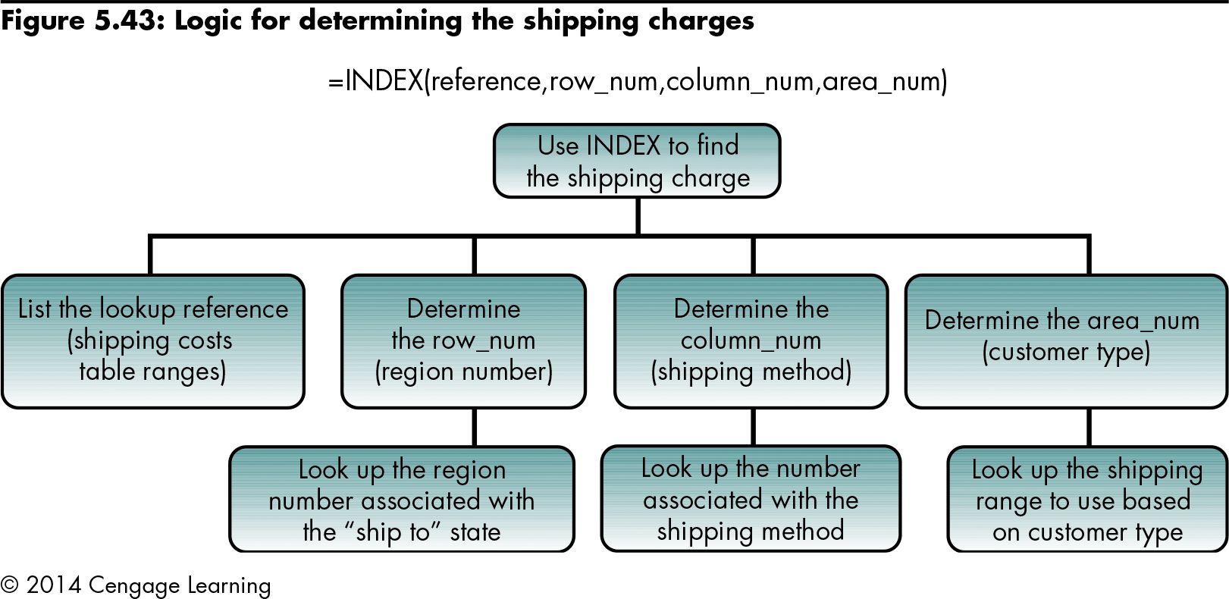
Calculating the Shipping Costs Using MATCH and INDEX Functions (continued)
Level 3 home

Slide 48
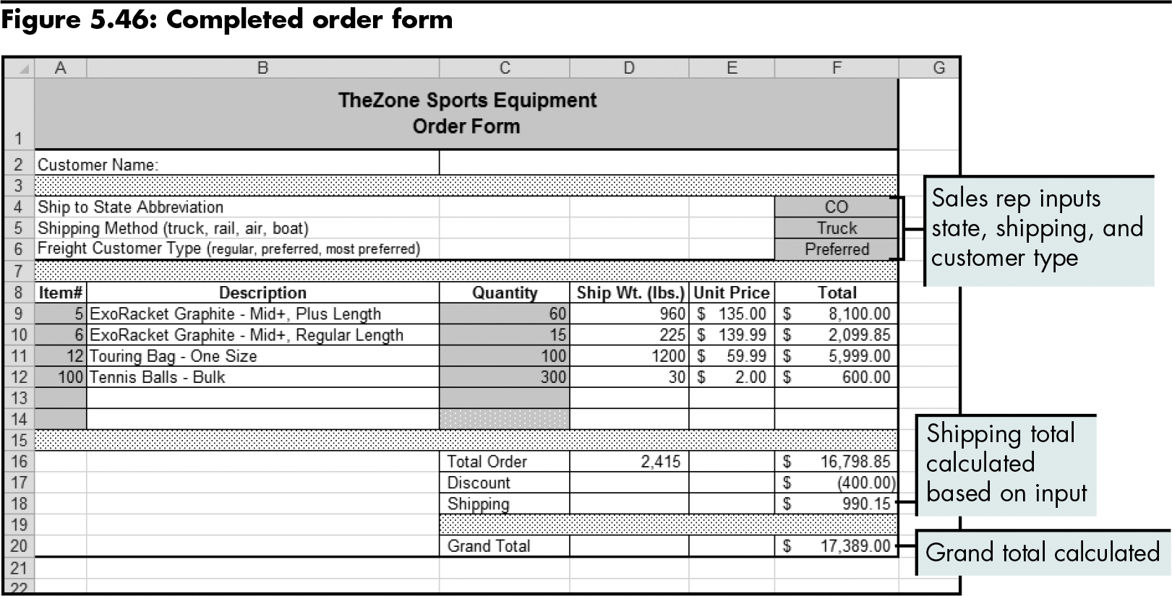
Calculating the Shipping Costs Using MATCH and INDEX Functions (continued)
Level 3 home

Slide 49
Level 3 Summary
To solve more complex problems, nest Reference and Lookup functions using the IF, IS, INDEX, CHOOSE, and MATCH functions
ISBLANK
One of nine IS functions, which all check for a condition and then return a TRUE or FALSE value
Checks whether a specified value refers to an empty cell

Slide 50
Level 3 Summary (continued)
INDEX
Returns the value in a table based on specified row and column numbers
CHOOSE
Returns a value/range for up to 29 corresponding values
MATCH
Returns the relative position of an item in a list

Slide 51
Chapter Summary
Performing basic lookups to calculate and evaluate data
Performing more complex lookups involving multiple worksheets and multidimensional tables
Nesting lookup and reference functions to retrieve and calculate data

